Slide 1

MOOcs SEMINar
ANIRUDDH JOSHI
(BTECH CSE III)
(Section-A)
Roll No:- 21
University Roll no:- 2161076

Slide 2
>>To develop a software for solving financial applications of a customer in banking environment in order to nurture the needs of an banking user by providing various ways to perform banking tasks. >>Banking Management System thus ensures smooth operation of the Real-Estate management tasks as well as keep the information about the employees and their salary.
AIM OF THIS PROJECT

Slide 3
DESCRIPTION
BANKING SYSTEM IS A SOFTWARE FOR ORGANIZING AND MANAGING THE BANKING TASKS DIGITALLY.
IT IS AN INFORMATION SYSTEM WHICH IS MAINLY FOCUSED ON THE OPERATIONS LIKE ADDING NEW CUSTOMERS IN THE BANK,DEPOSIT ,WITHDRAW, TRANSFER MONEY AND STATEMENT OF THE CUSTOMER ,ETC.

Slide 4
LANGUAGE USED :C++
VARIOUS CONCEPTS OF OOPS AND FILE HANDLING ARE USED IN MAKING OF THIS PROJECT.
THE CPP CODE USED FOR BANK MANAGEMENT SYSTEM INCLUDES FILE SYSTEM ACCESS ,SO ALL THE DATA GETS STORED IN A EXTERNAL FILE NAMED ”detail.dat ” BINARY FILE THAT WILL BE CREATED DURING RUNTIME.

Slide 5
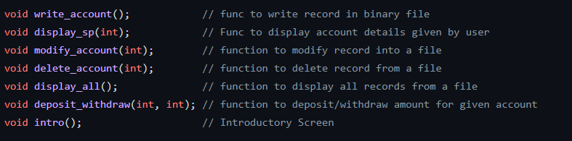
Functions used in the program

Slide 6
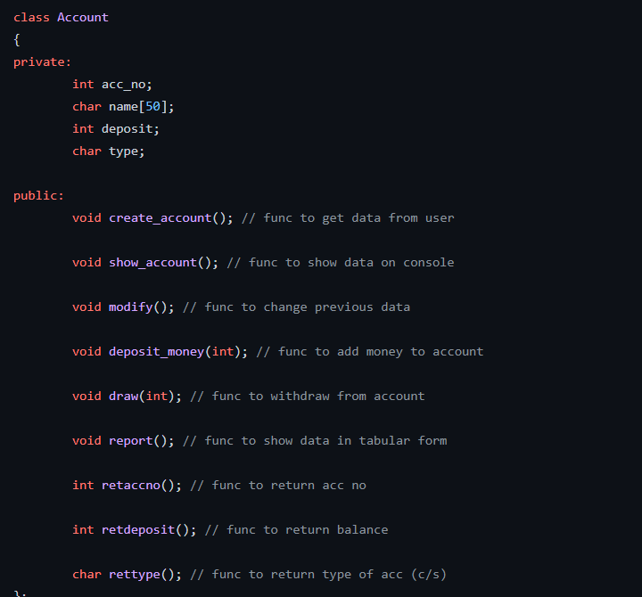
Class used in the PROGRAM A Class named ACCOUNT IS CREATED WITH FOLLOWING DATA MEMBERS AND FUNCTIONS:

Slide 7
Modules USED IN PROJECT
NEW ACCOUNT | Opens a new account for the user by accepting input such as account number, name and minimum balance And account type.
CLOSE AN ACCOUNT | Closes the selected account from the bank.
MODIFY AN ACCOUNT | Selecting this will allows to modify by accepting input such as account number, name and amount.
ALL ACCOUNT HOLDER LIST | Displays the list of a customer’s account details comprising of account number, name and balance amount.

Slide 8
MODULES USED IN PROJECT
DEPOSIT AMOUNT | Provides options to deposit amount from the given account number .
WITHDRAW AMMOUNT | Provides options to withdraw amount from the given account number.
BALANCE ENQUIRY | Displays the list of a customer’s account details comprising of account number, name and balance amount.

Slide 9
CONCLUSION
THIS BANKING SYSTEM WILL SERVE AS USEFUL APPROACH TO DEPOSIT AND WITHDRAW THE MONEY FOR THE PERSON.
BANK SYSTEM DEVELOPED IS USER FRIENDLY.
IT REDUCES MANUAL WORK.

Slide 10
THANK YOU

